Slide 1
Scientific Method
Tuesday, 7/29/14
Q1 Wk2 D2
Concept 1: Observations, Questions & Hypothesis
PO1: Evaluate scientific information for relevance to a given problem
PO2: Develop questions from observations that transition into testable hypotheses.
PO3: Formulate a testable hypothesis
PO4: Predict the outcome of an investigation based on prior evidence, probability and/or modeling (not guessing or inferring).
Notes:
Students only need to write what is UNDERLINED

Slide 2
Steps to the scientific method?
1ST YOU MAKE OBSERVATIONS
2nd ask questions
3rd come up with a possible hypothesis
4th perform your experiment
5th analyze your data
6th make conclusions

Slide 3
Causal VS Descriptive
There 2 types of questions: CAUSAL & DESCRIPTIVE
CAUSAL:
-questions into the cause(s) or explanation(s)
of a phenomenon by asking “WHY” or “HOW”
something happens or the way it is.
DESCRIPTIVE:
-asks “WHAT”, “WHERE”, “WHEN”,
& “WHO” of some observed object, an event or
situation.

Slide 4
WHAT TYPES OF QUESTIONS ARE THESE?
Why is the sky blue?
Causal
Who are my lab partners?
Descriptive
What am I going to learn in this class?
Descriptive
How does it get so hot in Arizona?
Causal
When does school start?
Descriptive
Why do dogs bark?
Causal
Notes:
Practice questions; ask the class as a whole if they are causal or descriptive; explain WHY each one is Causal or Descriptive

Slide 5
WORKING THE WASHING MACHINE
It’s time for you to do a load of laundry.
You go to start the washing machine, but nothing happens ☹
Come up with a causal question &
a descriptive question:
Causal:
Descriptive:

Slide 6
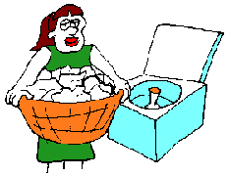
WHY WON'T THE WASHER START?

Slide 7
Causal & Descriptive
Practice worksheet! ☺
Attach into sci. ntbk

Slide 8
Now come up with
POSSIBLE
reasons why it won't start

Slide 9
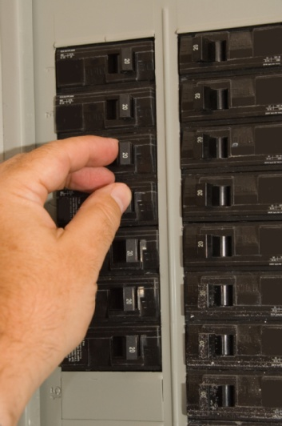
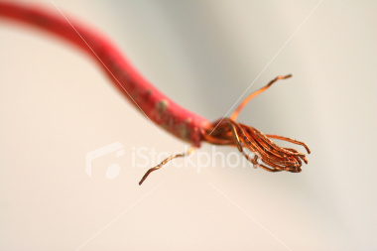
it's not plugged in
the circuit breaker is out
there is a wire loose

Slide 10
Those possible explanations were….
HYPOTHESES

Slide 11
WRITING HYPOTHESES
WHAT IS A HYPOTHESIS ANYWAY???
Notes:
Ask the class to answer this question & share their answers

Slide 12
A Hypothesis is…
A reason supporting / justifying your prediction
It is NOT an educated guess!

Slide 13
Prediction
What you think will happen
Prediction + Hypothesis
=
CLAIM

Slide 14
Let’s practice making a CLAIM
Scenario 1
Homework and class grades
Make your claim, remember:
CLAIM = (Prediction) + (Hypothesis)
If I do homework my grade will be increase, due to consistent practice of the material

Slide 15
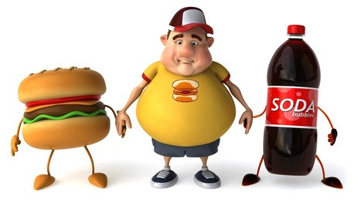
Let’s practice making a CLAIM
Scenario 2
Working out and obesity
Make your claim, remember:
CLAIM = (Prediction) + (Hypothesis)
Working out will decrease obesity because burning calories causes weight loss.

Slide 16
Claims Practice Worksheet
Handout- in sci. ntbk

Slide 17
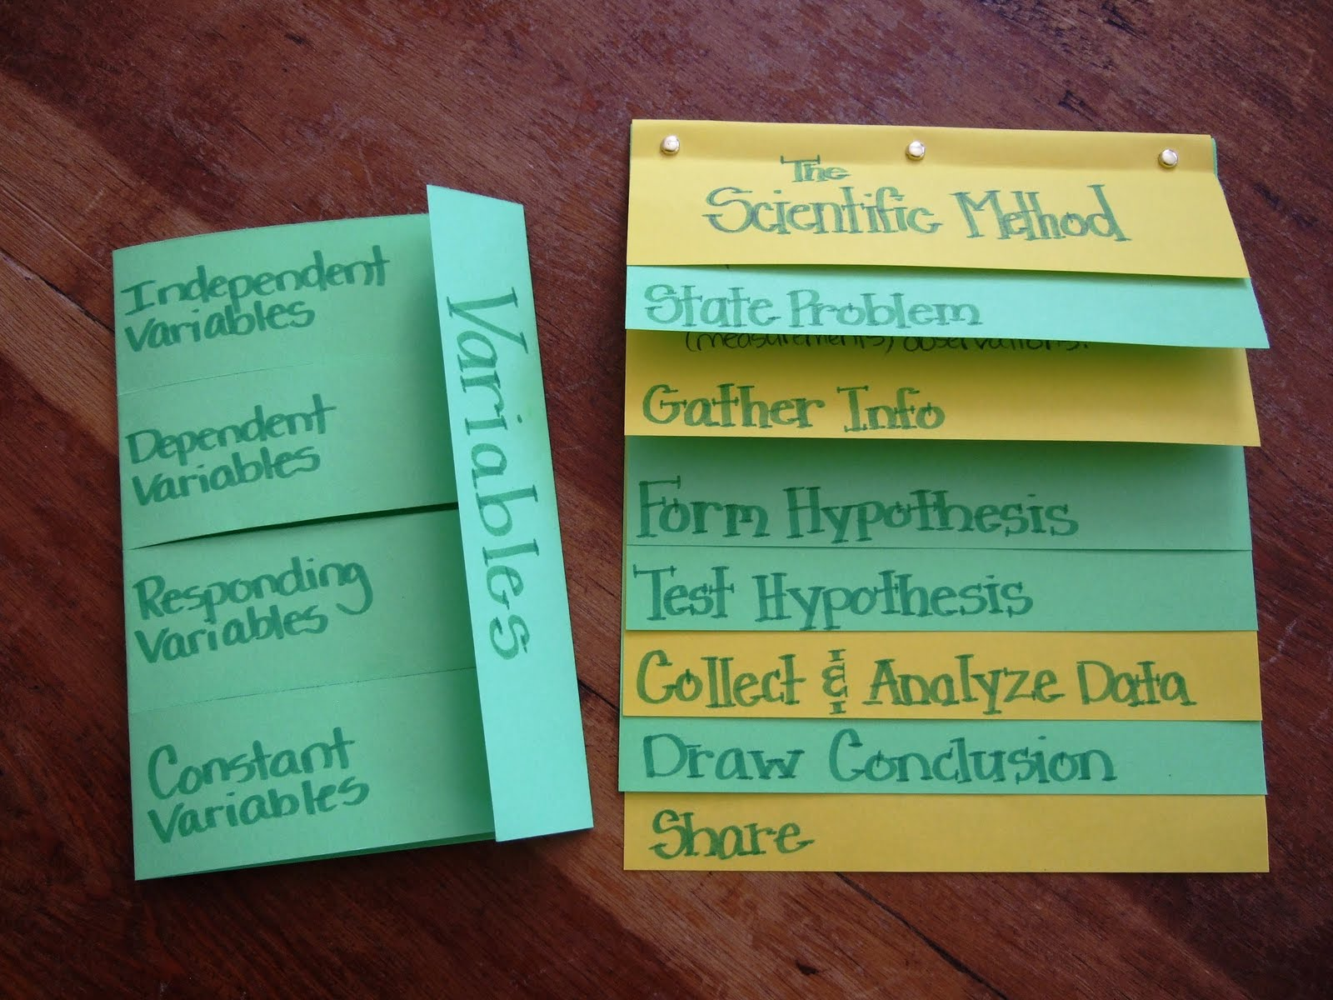
Let’s make a foldable!

Slide 18
Experiment Variables
Q1 WK2 D5
INDEPENDENT VARIABLE
2. DEPENDENT VARIABLE
3. CONSTANTS
4. CONTROL GROUP
FOLDABLE!

Slide 19
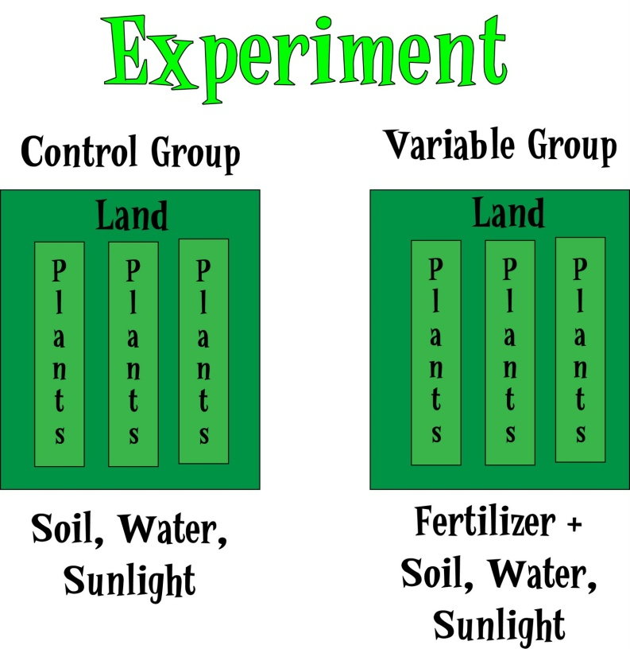
1. INDEPENDENT VARIABLE (IV)
The variable that is being CHANGED or MANIPULATED
Also known as the IV in an experiment.
In the picture to the left, what is the I.V.?
(The variable being CHANGED / MANIPULATED)
Fertilizer!
Notes:
Explain the picture and how the FERTILIZER is the I.V.

Slide 20
2. Dependent Variable: (DV)
The responding variable; the variable that is being MEASURED.
Also known as the DV in an experiment!
EXAMPLE:
A group of students were given a short course in speed-reading. The instructor was curious if a monetary incentive would influence performance on a reading test taken at the end of the course. Half the students were offered $5 for obtaining a certain level of performance on the test, the other half were not offered money.
Independent Variable:
Dependent Variable:
The incentive (money) after a course in speed-reading
Performance on a reading test
Notes:
Call on a student to answer the I.V.; call on another student for the D.V.

Slide 21
Independent VS Dependent Variable
EXAMPLES:
1. There will be a statistically significant difference in graduation rates of at-risk high school seniors who participate in an intensive study program as opposed to at-risk high-school seniors who do not participate in the intensive study program."
IV:
DV:
Intensive study program
Graduation rate of at-risk high school seniors
Notes:
Give 1 post-it per table / pair, put answer under appropriate answer

Slide 22
Independent VS Dependent Variable
EXAMPLES:
A scientist wants to investigate whether plants need sunlight to grow. The hypothesis being tested is:
2. “Plants require sunlight to grow.” The scientist placed one tray of sunflower seedlings in the sun and another tray of sunflower seedlings in a cupboard in the laboratory. The seedlings were watered and after 6 weeks the height of each seedling was measured.
I.V. :
D.V. :
The amount of sunlight given to each tray of sunflower seedlings
The height of each sunflower seedlings after 6 weeks
Notes:
Give 1 post-it per table / pair, put answer under appropriate answer

Slide 23
3. CONSTANTS
All variables that MUST remain the same during the experiment.
Mrs. Ellison has a patch of sweet corn behind the school. In the past, she has only planted corn without fertilizer. She wants to see if the sweet corn will grow better with a “fertilizer” from her cat’s litter box. Mrs. Ellison plants one row of corn with the “fertilizer” and another row without the fertilizer. Both rows were planted in the same area and in the same type of soil. Both rows were also planted with the same exact type of seed.
Seed type 2. Soil type 3. Area planted 4. Sun exposure
5. Amount of water given 6. Tools used to plant seeds 7….
Notes:
Ask students to share possible constant; write these on the board, then show the possible answers…

Slide 24
Identifying Variables- Practice
Fertilizer in soil increases flower production.
IV:______, DV: _______, 2 Controls: _____ & _____
2. If zinc tablets are taken, then the number of colds per year is reduced.
IV: _____, DV: ______, 2 Controls: _____ & _____
3. If water is present, then the number of bacteria in garbage bins increases.
IV: _____, DV: _____, 2 Controls: _____ & _____
In your science ntbk
Notes:
“White boards”

Slide 25
4. CONTROL GROUP
A group that is NOT being manipulated or is NOT BEING TESTED by an experimental process.
It is used to compare results to the experimental group.
Notes:
Explain the purpose of the control group in an experiment; it’s used to COMPARE & VERIFY

Slide 26
Kindergarten children will select certain types of food because of its color. Sandy put food coloring into 4 identical bowls of mashed potatoes as follows: Bowl 1 (green), Bowl 2 (red), Bowl 3 (blue), and Bowl 4 (yellow). Each child chose a scoop of potatoes of the color of their choice. Sandy did this experiment using 100 kindergarten students. She recorded the number of students that chose each color.
-Independent Variable:
-Dependent Variable:
-Controlled Variable(s):

Slide 27
Plants compete for space because they need room to grow. Mary bought a mixture of flower seeds and some potting soil. Into each of the 5 plastic cups, she placed the same amount of soil. The following numbers of seeds were placed in each cup: Cup 1 (2 seeds), Cup 2 (4 seeds), Cup 3 (8 seeds), and Cup 4 (16 seeds). In the last cup she planted 32 seeds. After 25 days, she determined which set of plants looked best.
Independent Variable:
Dependent Variable:
Constants:

Slide 28
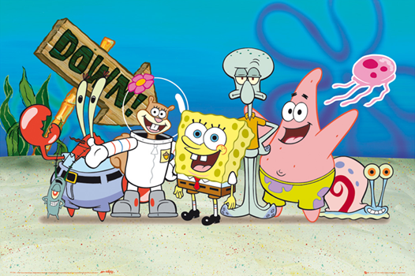
SpongeBob Variables Practice!!!

